Slide 1
70-533 : Exam Prep Session Get ready for- Implementing Microsoft Azure Infrastructure Solutions

Slide 2
Configure Scale & Resilience

Slide 3
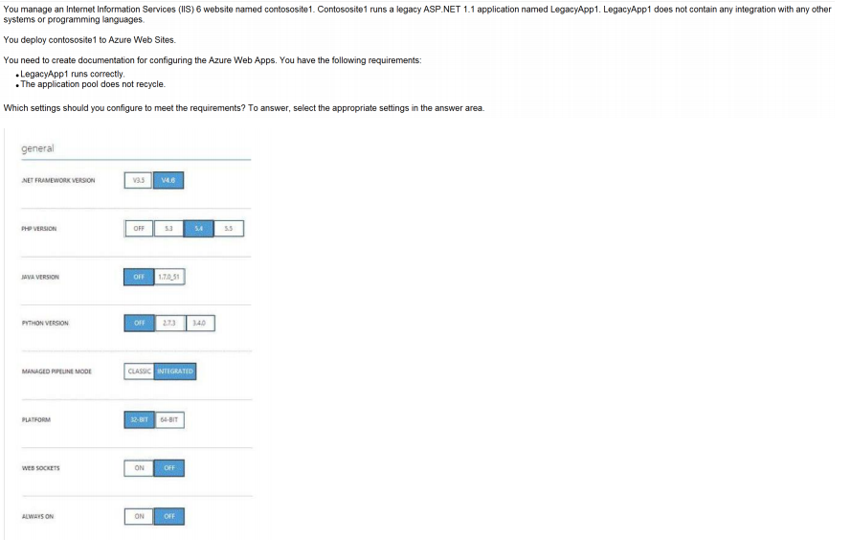
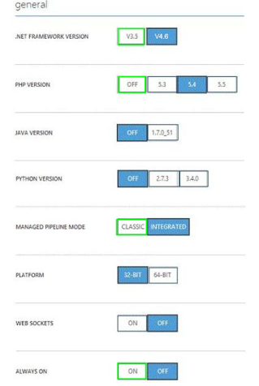
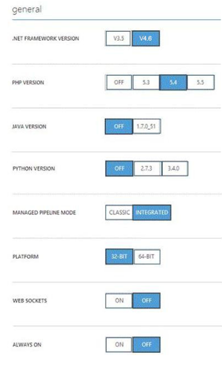
Ans =

Slide 4
Explanation:
* Managed Pipeline Mode. Sets the IIS pipeline mode. Leave this set to Integrated (the default) unless you have a legacy website that requires an older version of IIS *
Always on: ON Always On. By default, websites are unloaded if they are idle for some period of time.
This lets the system conserve resources. In Basic or Standard mode, you can enable Always On to keep the site loaded all the time. If your site runs continuous web jobs, you should enable Always On, or the web jobs may not run reliably.

Slide 5
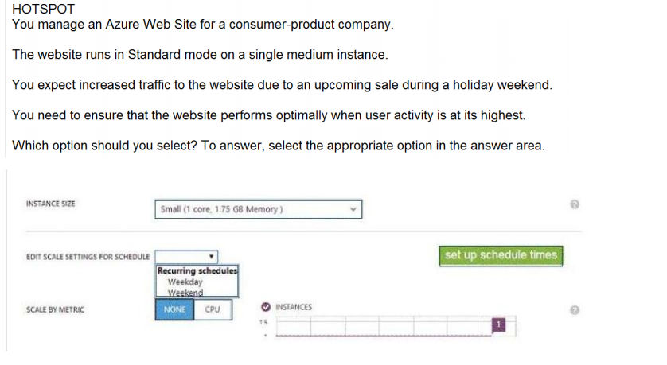
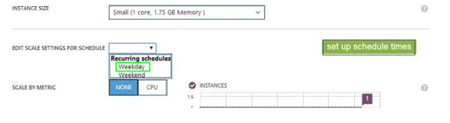
Ans =

Slide 6
Managing Hosting Plan

Slide 7
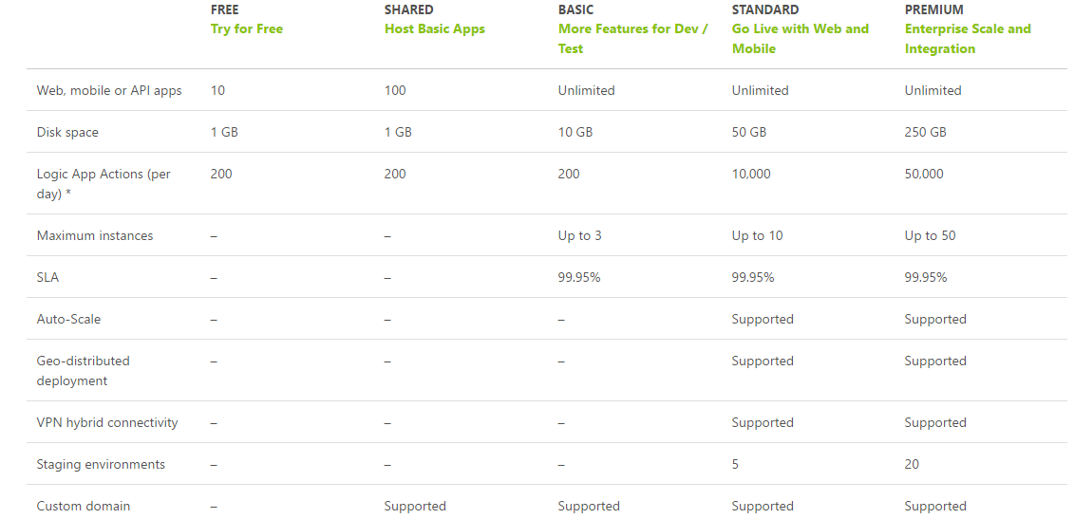

Slide 8
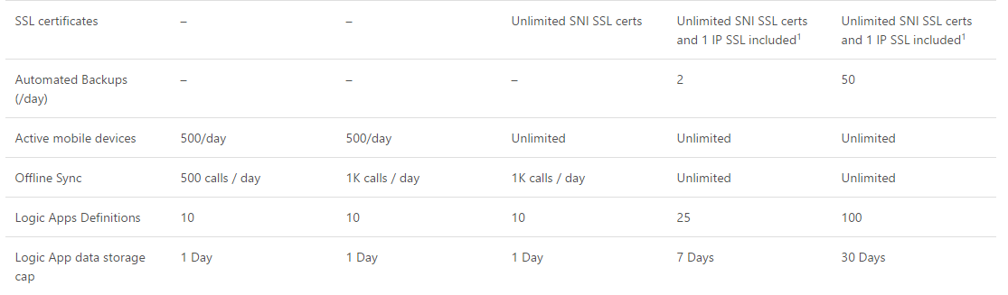

Slide 9
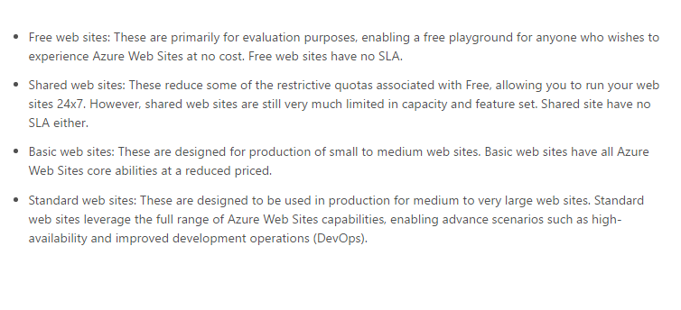

Slide 10
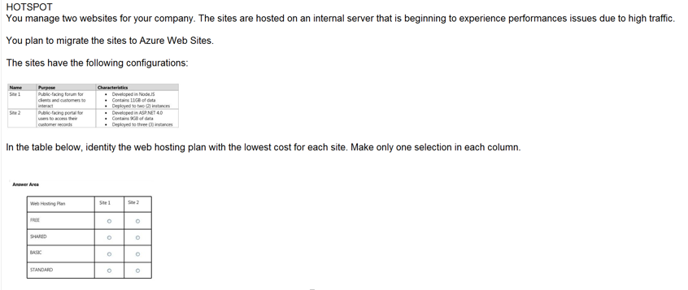
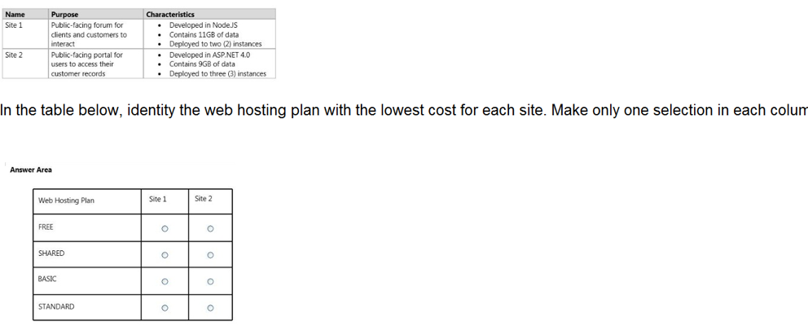
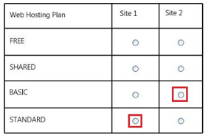
Ans =

Slide 11
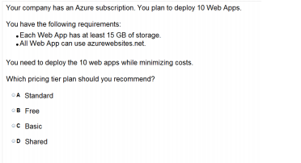
Ans = A Free- 1 GB Shared – 1 GB Basic- 10 GB Standard – 50 GB Premium – 250 GB

Slide 12
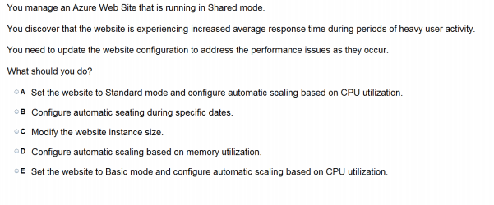
Ans – A Automatic Scalling supported in Standard only

Slide 13
Explanation:
Scaling to Standard Plan expands the Capacity section to give the Instance Size and Instance Count options, and is also available in Basic mode. But The Edit Scale Settings for Schedule and Scale by Metric options is only in Standard.

Slide 14
Custom Domain & SSL Certificate

Slide 15
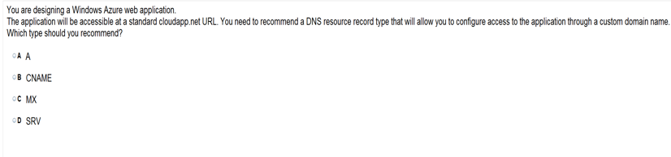
Ans = A

Slide 16
You create an Azure Active Directory (Azure AD)tenant named Tenant1 that has a domain name of tenant1.onmicrosoft.com. You need to add the contoso.com domain name to Tenant1. Which DNS record should you add to the contoso.com zone to be able to verify from Azure whether you own the contoso.comdomain?
A) standard alias (CNAME)
B) mail exchanger (MX)
C) host (AAAA)
D) signature (SIG)
E) A

Slide 17
You create an Azure Active Directory (Azure AD)tenant named Tenant1 that has a domain name of tenant1.onmicrosoft.com. You need to add the contoso.com domain name to Tenant1. Which DNS record should you add to the contoso.com zone to be able to verify from Azure whether you own the contoso.comdomain?
A) standard alias (CNAME)
B) mail exchanger (MX)
C) host (AAAA)
D) signature (SIG)
E) A

Slide 18
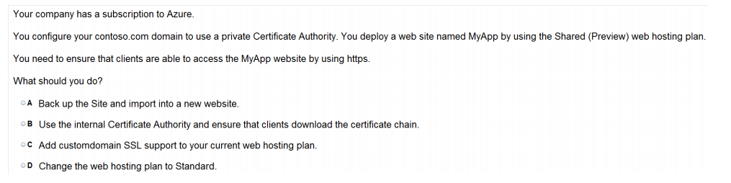
Ans = D

Slide 19
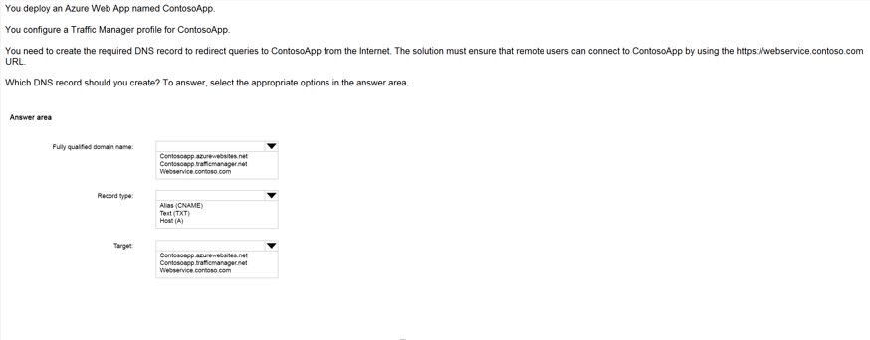
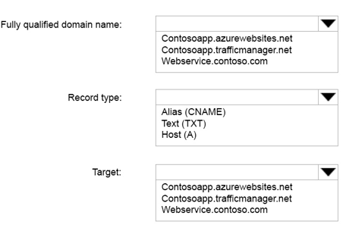
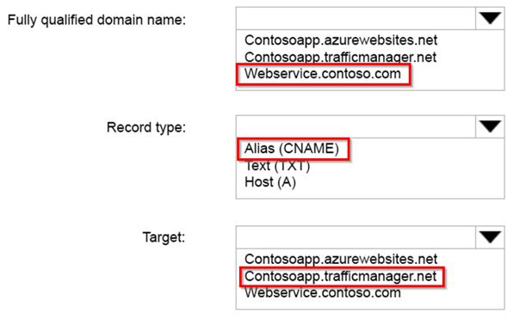
Ans =

Slide 20
Via https://webservice.contoso.com one should use the Traffic Manager Which DNS record should you create ? Match the Following-
Fully Qualified Domain Name | Contoso.trafficmanager.net
Record Type | https://webservice.contoso.com
Target | CName

Slide 21
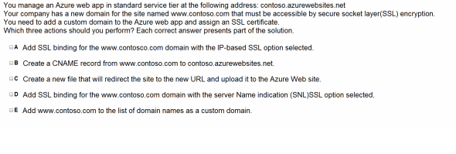

Slide 22
Ans – A & B & C What to Explain

Slide 23
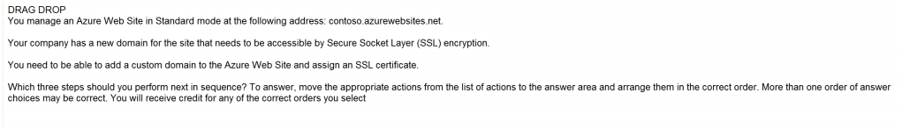
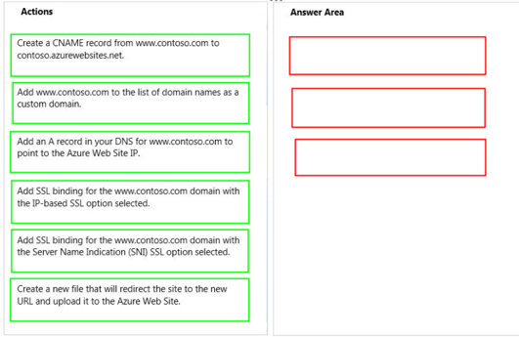
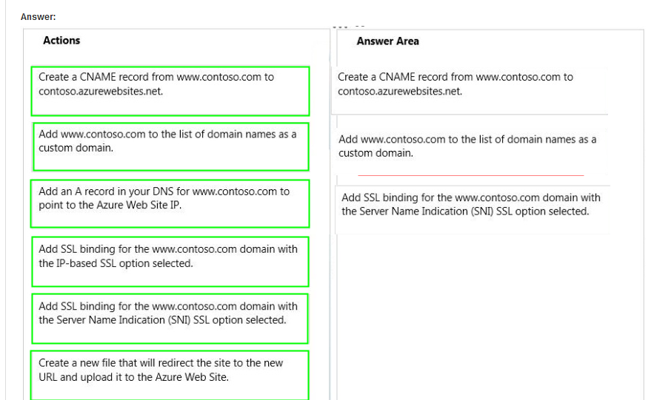
Ans =

Slide 24
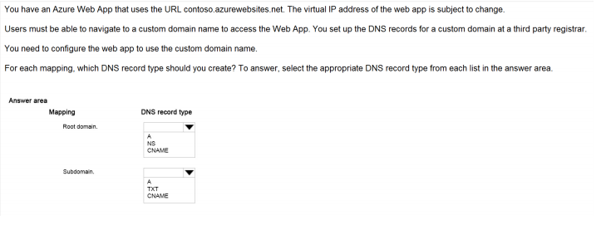
Ans – A and CNAME What to Explain Show Step by Step Domain Mapping

Slide 25
Diagnostic

Slide 26
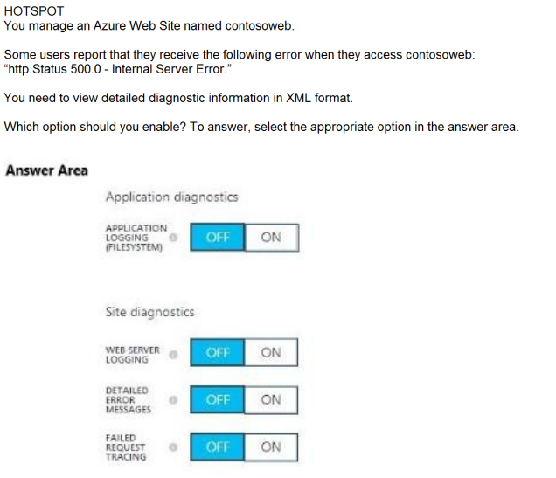
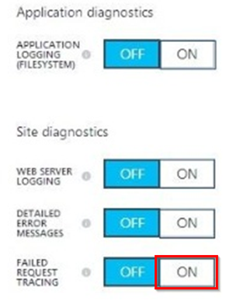
Ans = A

Slide 27
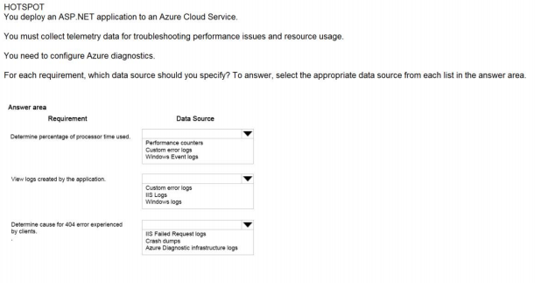
Ans – Performance Counters – Custom error logs - IIS Failed Request Logs What to Explain Azure Diagnostics

Slide 28
Analyse

Slide 29
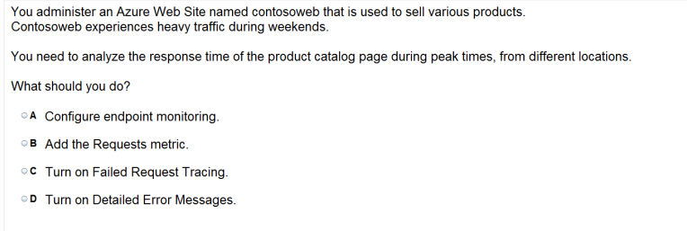
Ans – A

Slide 30
Monitoring

Slide 31
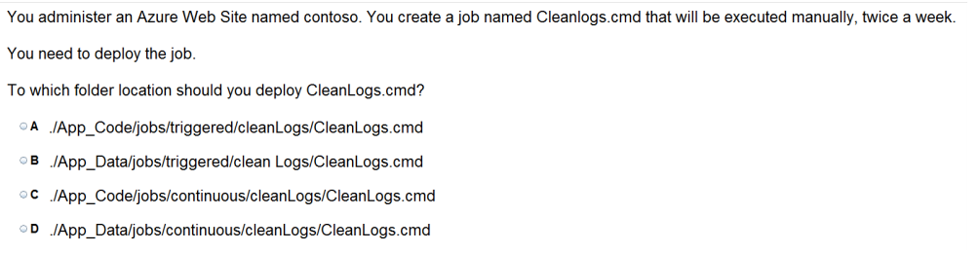
Ans =B

Slide 32
You administer an Azure Web Site named contoso. You create a job named flushlogs.cmd that will be executed manually, once a week. You need to deploy the job-
To which folder location should you deploy CleanLogs.cmd?
A../App_Code/jobs/triggered/flushLogs/flushLogs.cmd
B. ./App_Data/jobs/triggered/flushLogs/flushLogs.cmd
C. ./App_Code/jobs/continuous/flushLogs/flushLogs.cmd
D. ./App_Data/jobs/continuous/flushLogs/flushLogs.cmd

Slide 33
You administer an Azure Web Site named contoso. You create a job named flushlogs.cmd that will be executed manually, once a week. You need to deploy the job-
To which folder location should you deploy flushLogs.cmd?
A../App_Code/jobs/triggered/flushLogs/flushLogs.cmd
B. ./App_Data/jobs/triggered/flushLogs/flushLogs.cmd
C. ./App_Code/jobs/continuous/flushLogs/flushLogs.cmd
D. ./App_Data/jobs/continuous/flushLogs/flushLogs.cmd
Explanation: A WebJob is stored under the following directory in your site: site\wwwroot\App_Data\jobs\{job type}\{job name} Where {job type} can be either continuous for a job that is always running or triggered for a job that starts from an external trigger (on demand / scheduler).

Slide 34
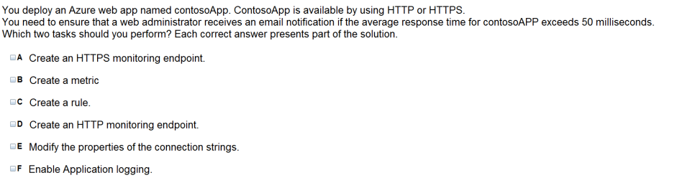
Ans = C & D

Slide 35
You have a website that can be access or availed on both HTTP and HTTPS( over SSL). We need to ensure that a web Admin receive a notification over email if the average response time is delayed over specified time. Which two tasks would you perform –
A) Create HTTP endpoints
B) Create Metric
C) Create Rule
D) Change Connection string
E) Auto Scale
F) Enable Application Logging
g) Create HTTPS endpoints

Slide 36
You have a website that can be access or availed on both HTTP and HTTPS( over SSL). We need to ensure that a web Admin receive a notification over email if the average response time is delayed over specified time. Which two tasks would you perform –
A) Create HTTP endpoints
B) Create Metric
C) Create Rule
D) Change Connection string
E) Auto Scale
F) Enable Application Logging
g) Create HTTPS endpoint

Slide 37
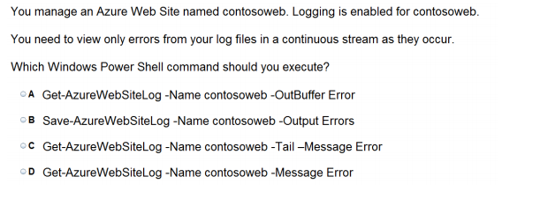
Ans = C

Slide 38
Ans = C

Slide 39
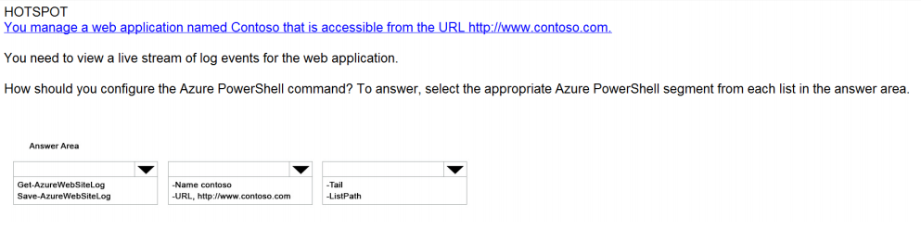
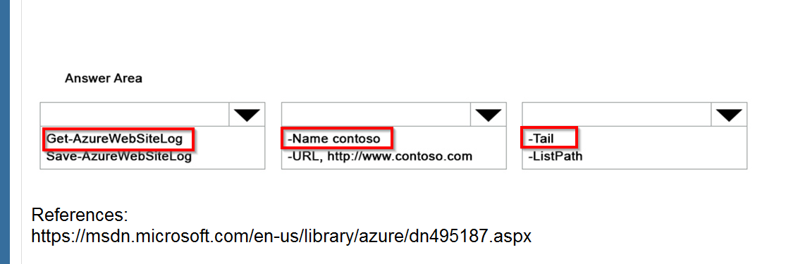
Ans =

Slide 40
Deployment Slot

Slide 41

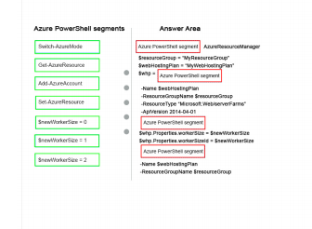
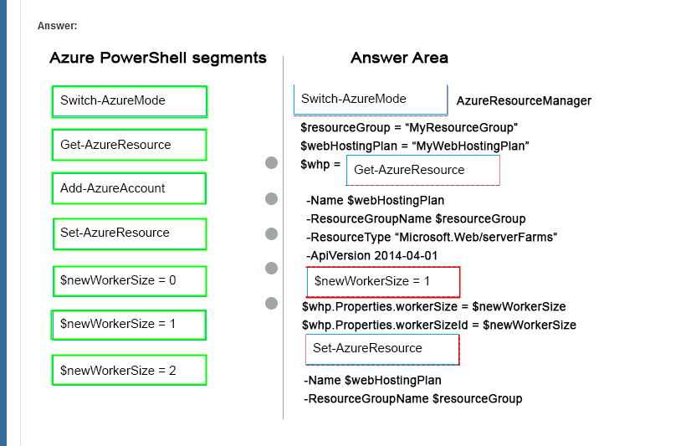
Ans =

Slide 42
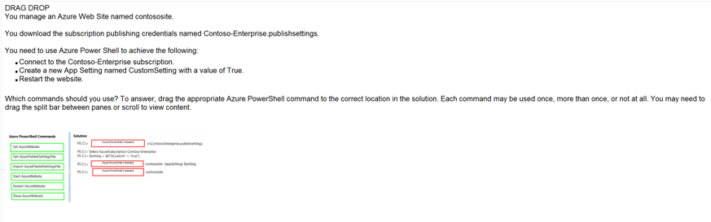
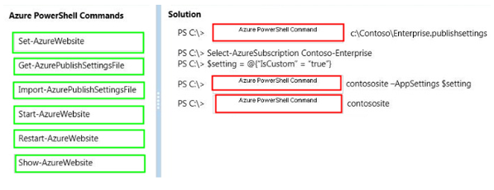
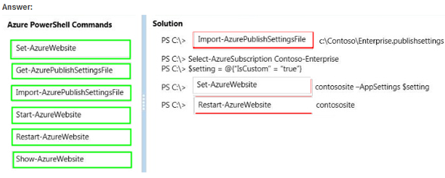
Ans =

Slide 43
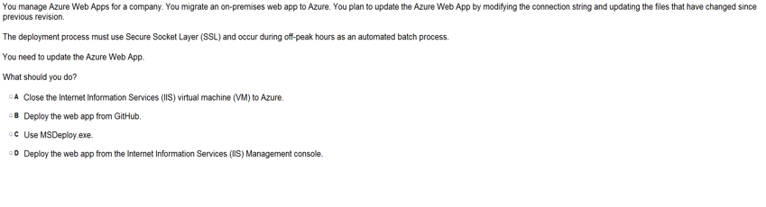
Ans = B

Slide 44
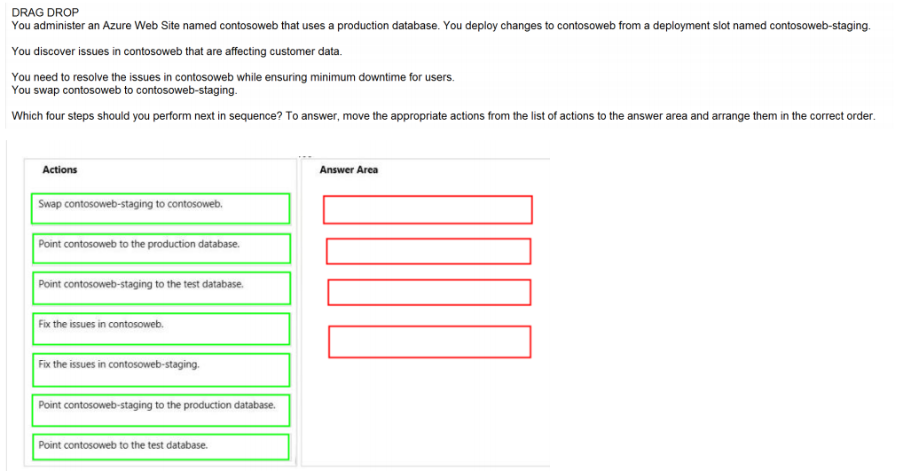
Ans =

Slide 45
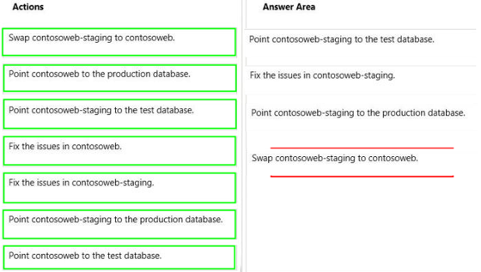

Slide 46
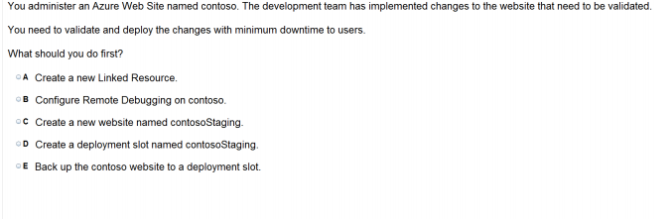
Ans – D Step by Step Deployment Slots

Slide 47
Ans =

Slide 48
Cross Platform CLI tool ( Command line Interface)

Slide 49
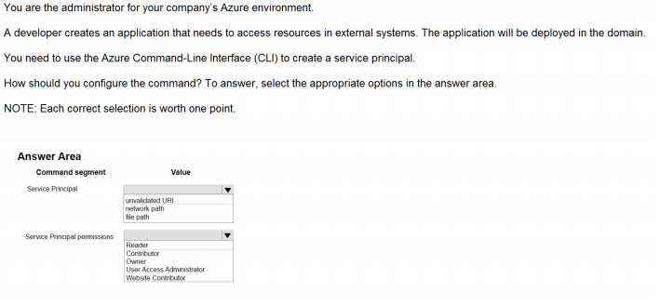
Ans = Service Principal – network path Service Pri. Permissions - Owner

Slide 50
App Service Autentication

Slide 51
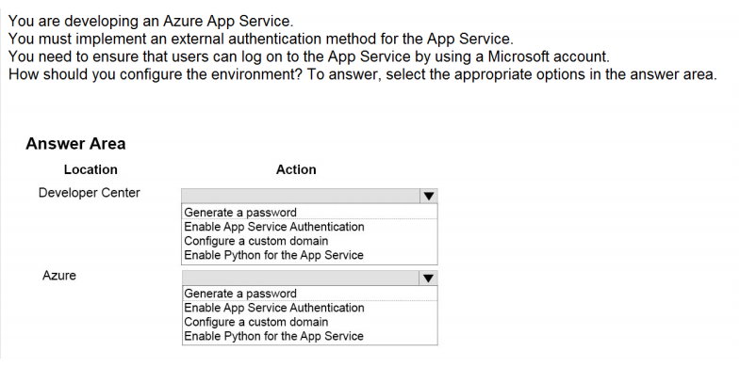
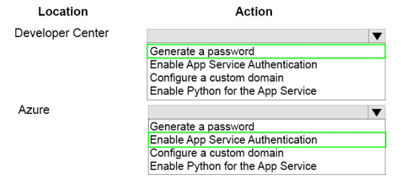
Ans =

Slide 52
Web Jobs

Slide 53
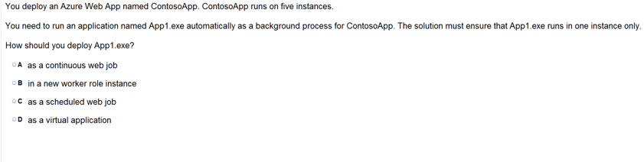
Ans = C

Slide 54
https://www.proprofs.com/quiz-school/story.php?title=mtg1mjywna99ud

